Slide 1

Classification of Myocardial Infarction
Date: 21/05/2023
Team 5:
Mr. Akshay Sanjiv Kamble
Ms. Sakshi Sanjay Bais
Mr. Prashant Punamchand Jadhav
Ms. Tanavi Sandip Daware
Mr. Rohit Ashok Patil
Ms. Sakshi Vijay Wagh
Ms. Nikhitha K R
Mentors:
Mr.Madishetti Rajshekar
Ms.Bapuram Pallavi

Slide 2
Business Objective:
Myocardial Infarction(Commonly known as “Heart attack”) is one of the most challenging problems of modern medicine. Acute myocardial infarction is associated with high mortality in the first year after it. The incidence of MI remains high in all countries. This is especially true for the urban population of highly developed countries, which are exposed to chronic stress factors, irregular and not always balanced nutrition.
The Given dataset consists of 124 variables with 1700 records of patients. Classify the Lethal outcome (cause) (LET_IS)(Y variable) by using the given dataset.

Slide 3
Project Architecture / Project Flow:
Decision Tree
Dataset
Logistic
SVM
Model Building
Random Forest
Prediction
Cleaning
Selection of model
ANN
EDA
KNN
Feature Engineering
XG Boost

Slide 4
Exploratory Data Analysis (EDA)

Slide 5
Overview of Dataset :
Dataset has 124 columns and 1700 rows indicating patient information . As ID column is just for reference we have 123 columns.
We have two types of data for column which are nominal and ordinal , which are represented by numerical values indicating different categories.
Dropping out 12 columns during model because they are related with lethal outcomes
columns(LET_IS).
Null values and their handling : We have 65 columns which have 0 to 3% null values, 54 columns have 3 to 50% null values while 4 columns null values greater than 50%. For columns having null value greater than 30% we decided to drop those columns. As for columns having null values less than 30%, we used df.fillna(df.median() , inplace=True) method to fill those values with median of that column.
Dataset has 0 duplicated values.

Slide 6
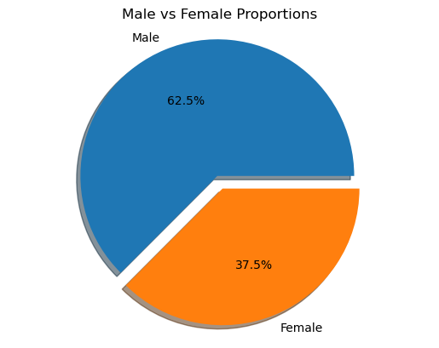
Pie Chart :
0: female 635 37.35% 1: male 1065 62.65% Gender (SEX): Males have a higher risk of heart attack than females.

Slide 7
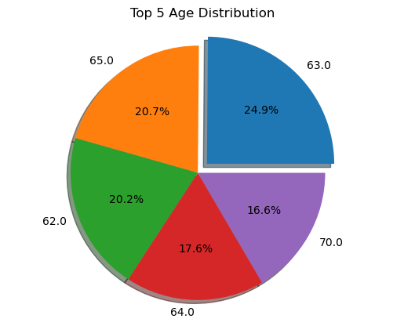
Pie Chart
Age (AGE): The risk of heart attack increases with age.

Slide 8
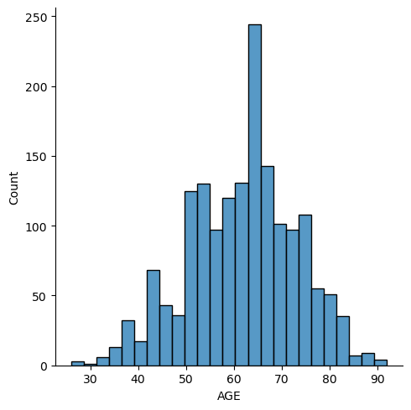
Histogram :
we can see that most of the age group patient are between 60-70.

Slide 9
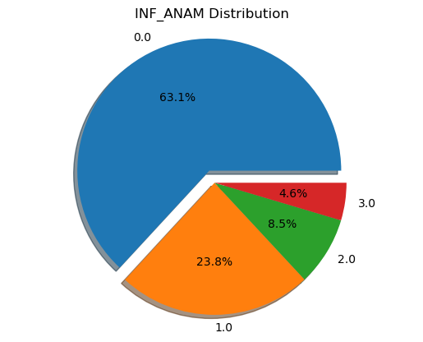
Pie Chart :
Quantity of myocardial infarctions in the anamnesis (INF_ANAM): The more heart attacks a person has had in the past, the higher their risk of having another one. 4.6% people having higher risk to get another one.

Slide 10
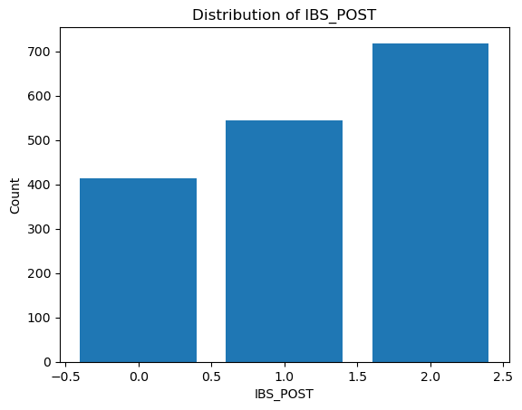
Bar chart :
Quantity Coronary heart disease (CHD) in recent weeks, days before admission to hospital (IBS_POST): Having CHD, especially unstable angina pectoris, in the weeks or days before hospital admission increases the risk of heart attack.

Slide 11
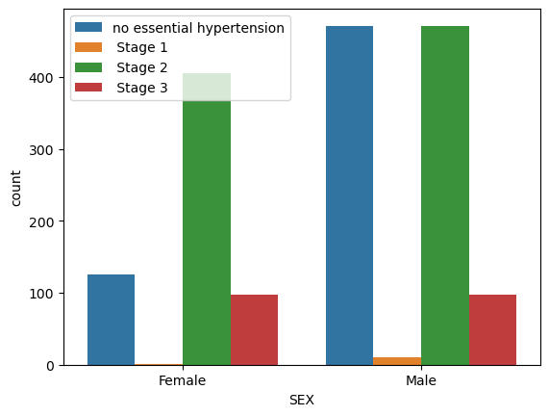
Bar chart :
Sex-wise distribution of GB column :
Stages of Hypertension relate with Gender. Here we see that Male patient have higher hypertension than female patient

Slide 12
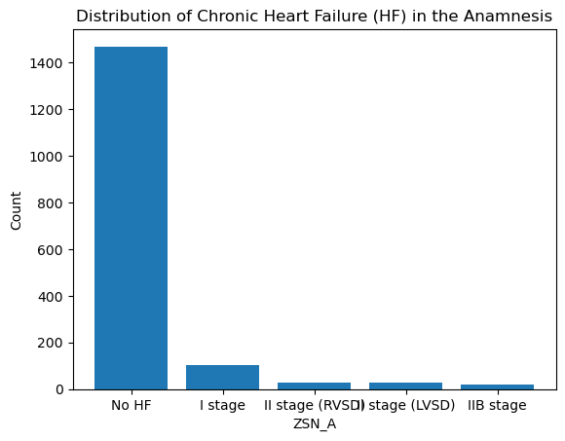
Bar chart :
Presence of HF in the anamnesis means that the patient has a history of being diagnosed with and experiencing chronic heart failure.
Having chronic heart failure indicates a higher risk of heart attack.
From this we can see that NO HF patient is higher than others i.e. this are new patient that have no previous heart failure diagnostic records.

Slide 13
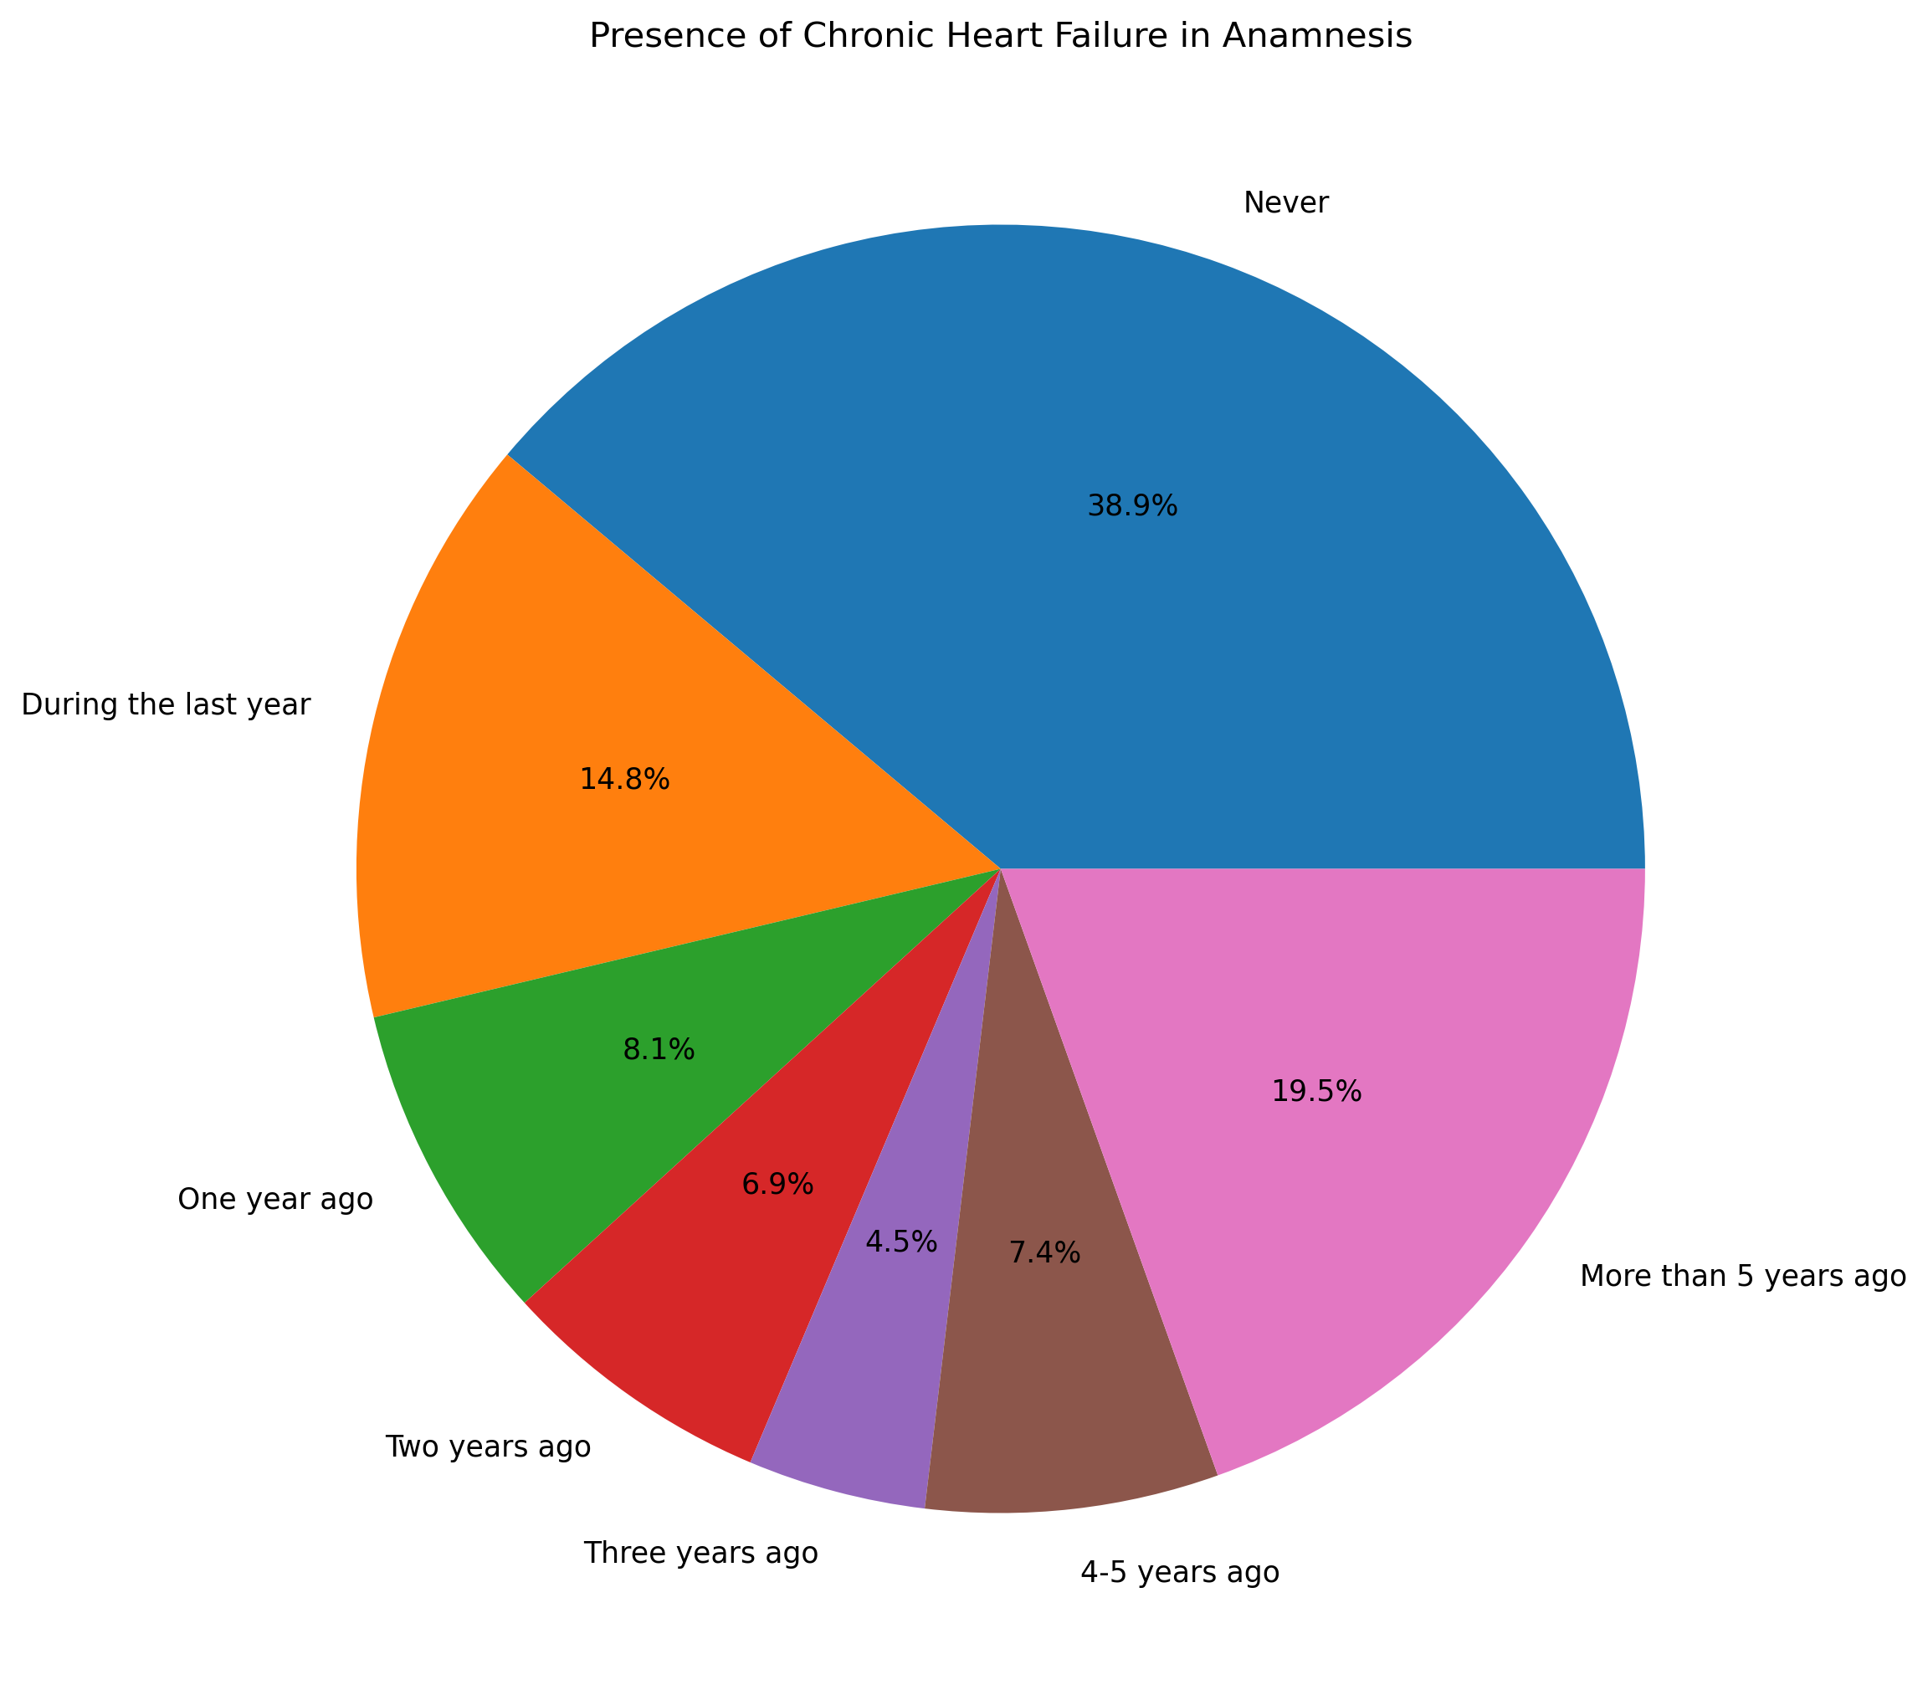
Bar chart :
Exertional angina pectoris in the anamnesis (STENOK_AN): Experiencing chest pain during physical activity may indicate a higher risk of heart attack.
We can see that Never category patients are around 38% and more than 5 year category patients are around 19.5%

Slide 14
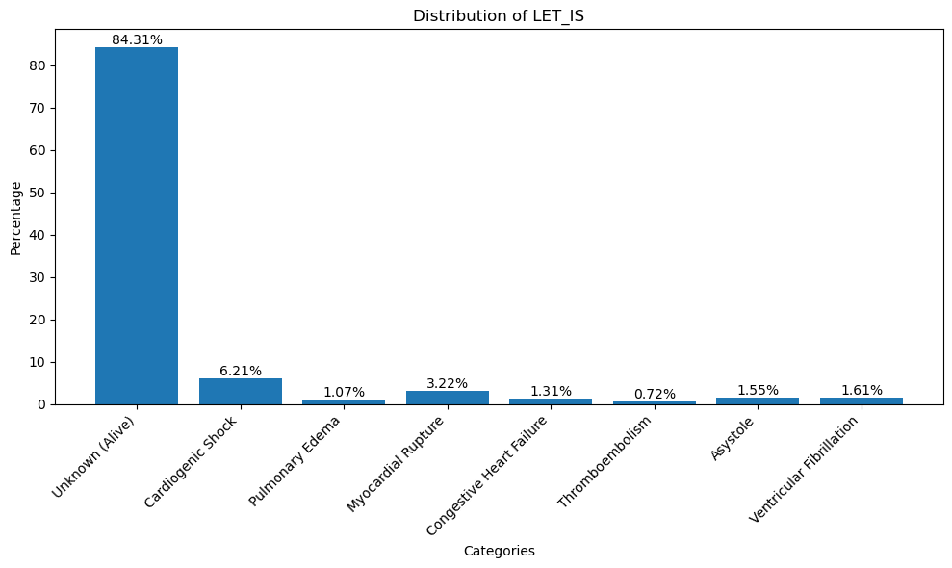
Bar chart :
LET_IS(Outcome) Distribution: we can see that Alive patients are around 84% and Cardiogenic shock patients are around 6%.

Slide 15
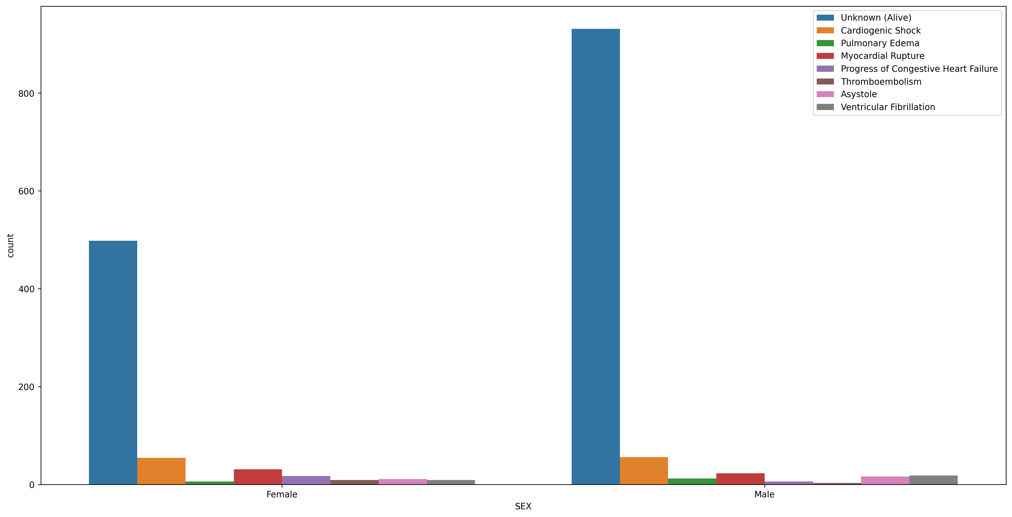
Bar chart :
Sex Columns relate with LET_IS outcome columns : we can see Male patient showing more alive and cardiogenic shock than female.

Slide 16
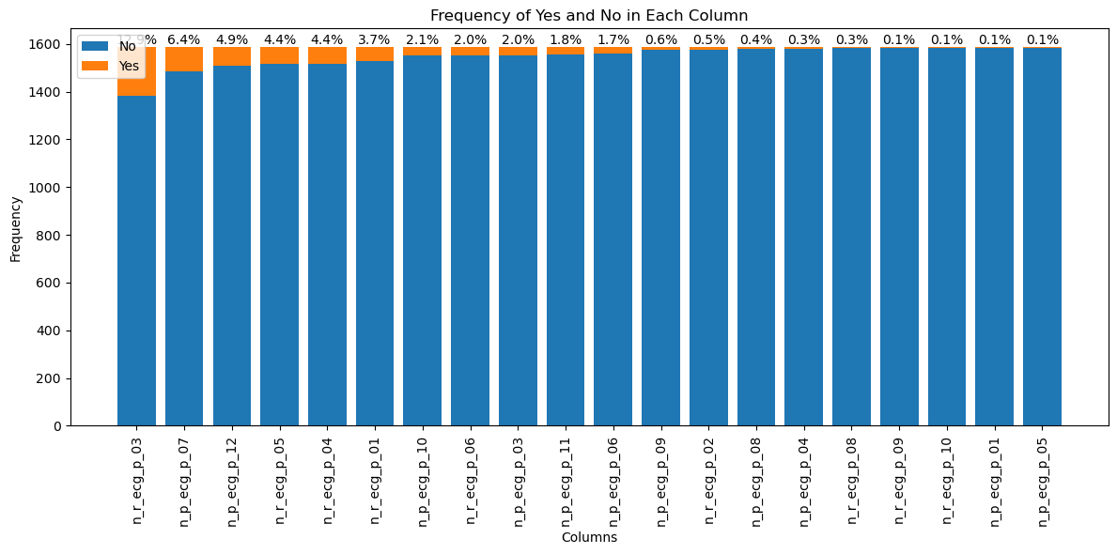
Bar chart :
ECG rhythms, which may indicate underlying heart conditions or abnormalities that could increase the risk of a heart attack.

Slide 17
Feature Engineering

Slide 18
Feature Engineering :
PCA (Principal Component Analysis) : It reduces dataset dimensionality by identifying important patterns in the data and creating new features called principal components. These components are combinations of original features. PCA eliminates redundant or less informative features, providing a more concise representation while retaining the essential characteristics of the data.
Lasso regularization (L1 regularization) : L1 regularization is a technique for feature selection in machine learning models. It penalizes less important features by reducing their coefficients or setting them to zero. This helps to eliminate irrelevant or redundant features, making the model more interpretable. Lasso regularization also prevents overfitting and improves the model's generalization to new data.

Slide 19
Model Building

Slide 20
Model Building :
Decision Tree: A decision tree is a graphical representation of a series of decisions and their potential outcomes. It is a simple yet powerful model that is easy to interpret and can handle both categorical and numerical data.
Random Forest: Random Forest is an ensemble learning method that combines multiple decision trees. It improves the accuracy and robustness of predictions by reducing overfitting and capturing the collective intelligence of the individual trees.
K-Nearest Neighbors (KNN): KNN is a simple and intuitive classification algorithm that assigns a new data point to the class based on the majority class of its nearest neighbors. It is non-parametric and does not require training, making it easy to implement.
Support Vector Machines (SVM): SVM is a supervised learning algorithm that finds the optimal hyperplane to separate classes in a high-dimensional feature space. It is effective for both linear and non-linear classification tasks and can handle datasets with complex decision boundaries.
Artificial Neural Networks (ANN): ANN is a computational model inspired by the biological neural networks in the human brain. It consists of interconnected nodes (neurons) organized in layers and can learn complex patterns and relationships in the data. ANN is widely used for tasks such as classification, regression, and image recognition.

Slide 21
Model Building :
XGBoost: XGBoost (Extreme Gradient Boosting) is an advanced gradient boosting algorithm that leverages the power of decision trees. It uses a gradient descent optimization strategy to iteratively build an ensemble of weak learners, achieving high predictive performance and efficient computation.
Logistic Regression: Logistic Regression is a statistical model used for binary classification tasks. It models the relationship between the input variables and the probability of belonging to a particular class using a logistic function. It is interpretable, efficient, and often serves as a baseline model in classification problems.

Slide 22
Model Accuracy & f1 Score :
Model Name | Accuracy | f1 Score
Decision Tree | 78% | 0.79
Random Forest | 99% | 0.99
Logistic Regression | 88% | 0.89
KNN | 96% | 0.96
SVM | 99% | 0.99
XGBoost | 98% | 0.99
Naïve Bayes | 64% | 0.64
Naïve Bayes (Gaussian) | 13% | 0.13
ANN | 87% | 0.87
HgradientBoosting | 99% | 0.99

Slide 23
Model Accuracy by Lasso Regularization :
Model Name | Accuracy | Training Acc. | Testing Acc.
Decision Tree | 0.78 | 0.93 | 0.86
Random Forest | 0.99 | 1.0 | 0.99
Logistic Regression | 0.88 | 0.88 | 0.88
KNN | 0.96 | 0.96 | 0.95
SVM | 0.99 | 0.99 | 0.98
XGBoost | 0.98 | 1.0 | 0.98
Naïve Bayes | 0.64 | 0.67 | 0.67
Naïve Bayes (Gaussian) | 0.13 | 0.12 | 0.13
ANN | 0.87 | 1.0 | 0.87
HgradientBoosting | 0.99 | 1.0 | 0.99

Slide 24
Model Selection for Deployment:
Model Accuracy without Feature Engineering :
Model Name | Accuracy | Training Acc. | Testing Acc.
Random Forest | 0.88 | 1.0 | 0.88
XGBoost | 0.88 | 1.0 | 0.88
ANN | 0.87 | 1.0 | 0.87

Slide 25
Let’s See Deployment

Slide 26

This is how our UI look like.
In this UI we can drop a files that have records of patients.

Slide 27
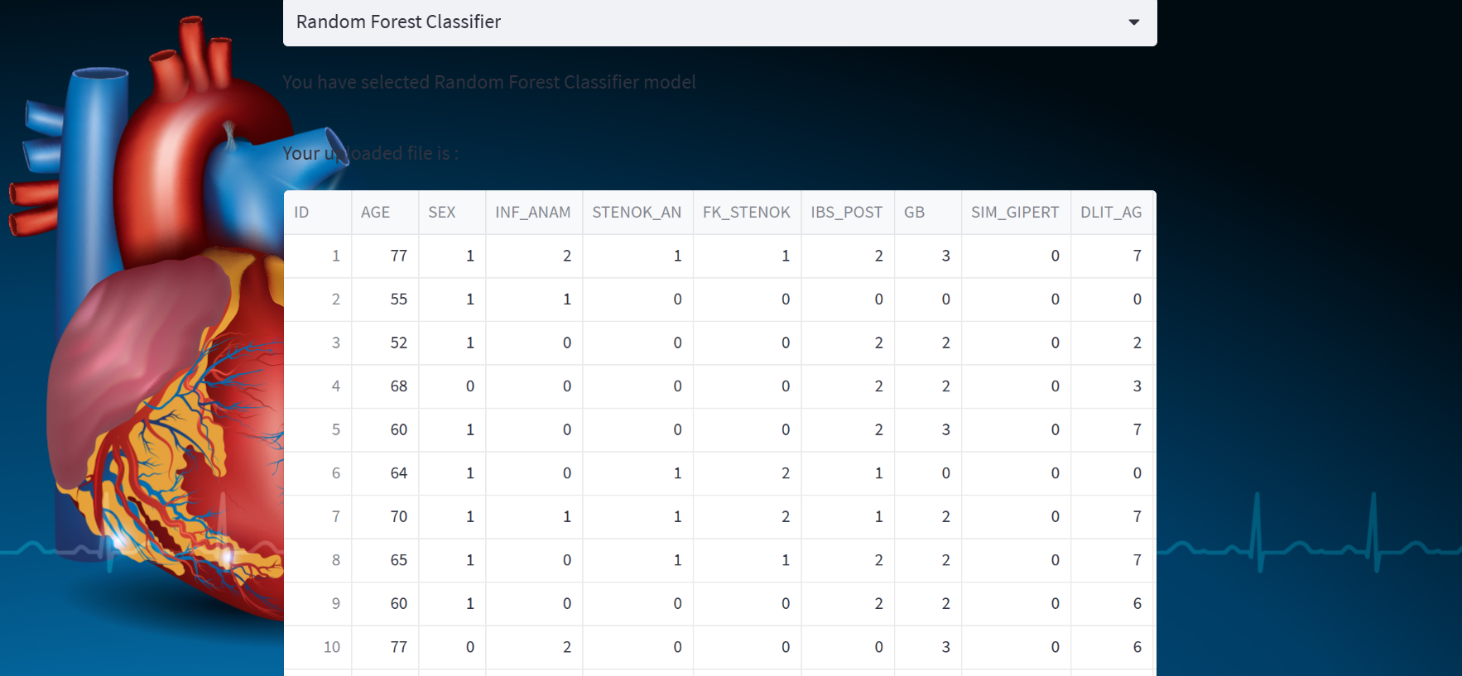
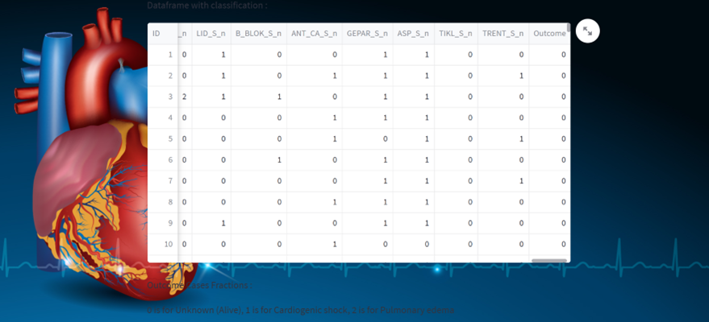
Prediction :
We can select any one model and based on that its give us prediction.

Slide 28

We can Check the infor. about features and also also download it the predicted dataset .

Slide 29
Challenges faced :
Overfitting: Addressing overfitting was a key challenge in the project.
Feature Engineering: Challenges were encountered in feature engineering, particularly with Lasso regularization and PCA. Lasso regularization helped select informative features and improve model interpretability. PCA reduced dimensionality while preserving essential characteristics.
Deployment using Streamlit: Deploying the model using Streamlit posed challenges related to compatibility, configuration, and dependencies. Troubleshooting and ensuring proper setup were crucial for successful deployment.
Despite these challenges, persistent problem-solving resulted in meaningful results for myocardial infarction classification.

Slide 30
Thank You !

